Slide 1
ECO 105Y Lecture 12 16 January 2017
Are Your Smart Choices Smart for All?

Slide 2
Microeconomics

Slide 3
Macroeconomics

Slide 4
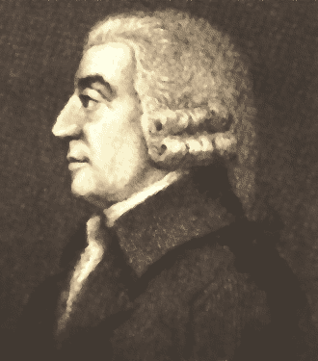
Adam Smith’s Invisible Hand
When an individual makes choices
“…he intends only his own gain, and he is in this... led by an invisible hand to promote an end which was no part of his intention.... By pursuing his own interest he frequently promotes that of the society more effectually than when he really intends to promote it.” Adam Smith, The Wealth of Nations, 1776

Slide 5

RECONCILING MACRO AND MICRO
Macroeconomics examines if smart microeconomic choices by individuals add up to smart macroeconomic outcomes for the economy as a whole.

Slide 6

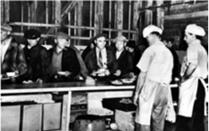
The Global Financial Crisis (2008–2009) involved housing bubbles that burst, falling asset prices, and failures of banks and financial institutions
Great Depression (1929–1933) involved financial bubbles that burst, high unemployment, falling living standards, bankruptcies, and government policy mistakes

Slide 7

Macroeconomics analyzes the performance of the whole Canadian economy and global economy — the combined outcomes of all individual microeconomic choices
Microeconomics analyzes choices that individuals in households, businesses, and governments make, and how those choices interact in markets

Slide 8
Fallacy of composition what is true for one is not true for all; the whole is greater than the sum of the individual parts
Paradox of thrift attempts to increase saving cause total savings to decrease because of falling employment and incomes

Slide 9
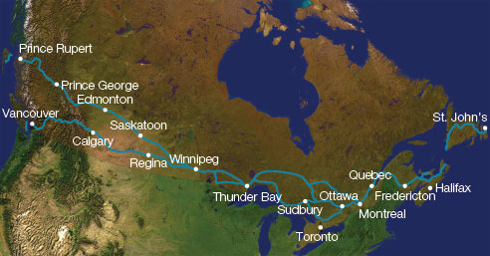
THINKING LIKE AN ECONOMIST
The circular-flow model, like all economic models, focuses attention on what’s important for understanding and shows how smart choices by households, businesses, and governments interact in markets.

Slide 10
An economic model is a simplified representation of the real world, focusing attention on what’s important for understanding
Circular flow model of economic life reduces complexity of the Canadian economy to three sets of players who interact in markets — households, businesses, and governments
In input markets, households are sellers, businesses are buyers
In output markets, households are buyers, businesses are sellers

Slide 11
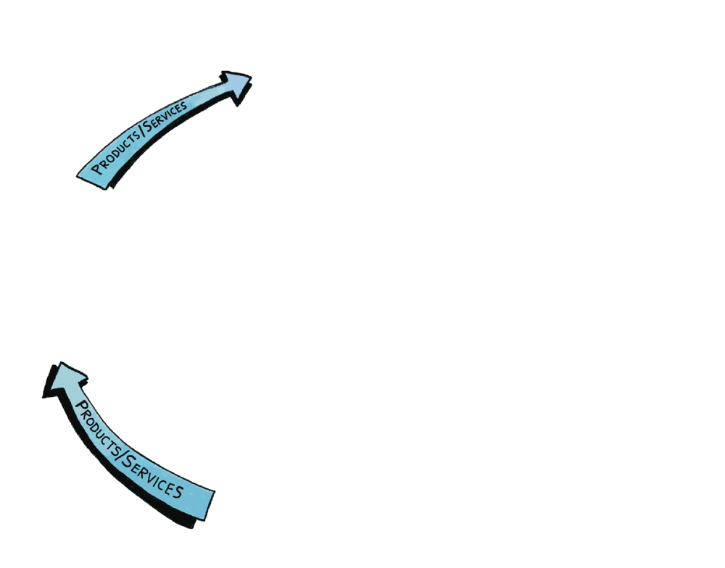
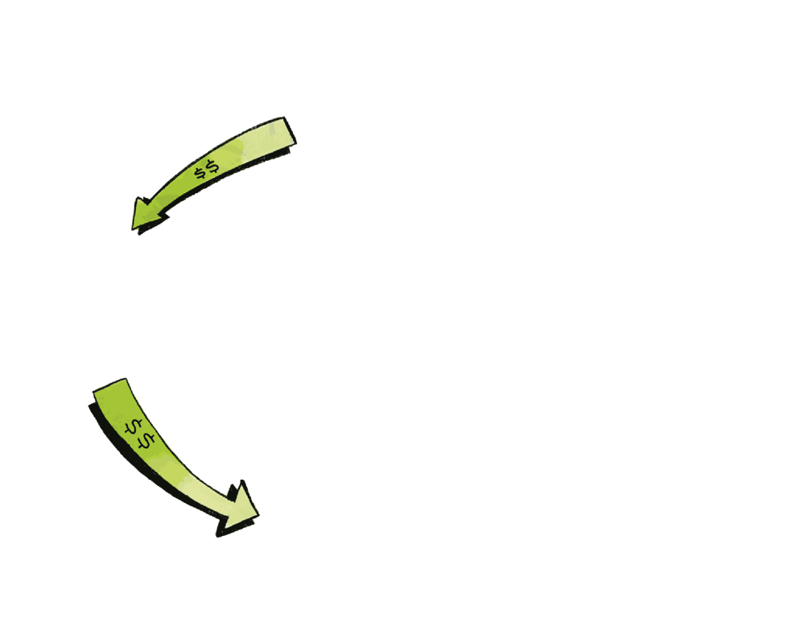
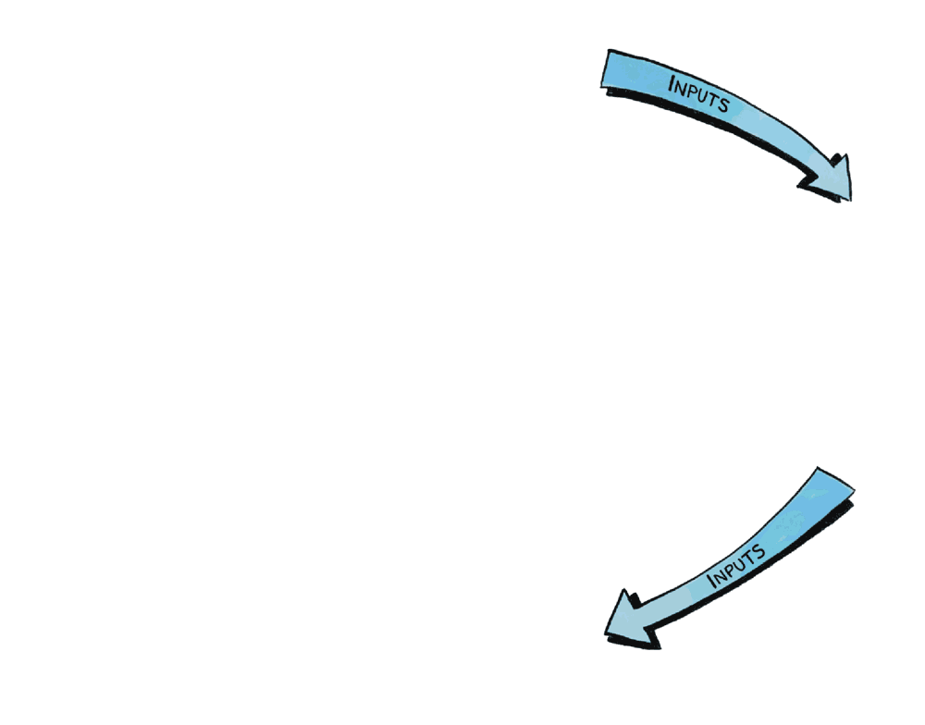
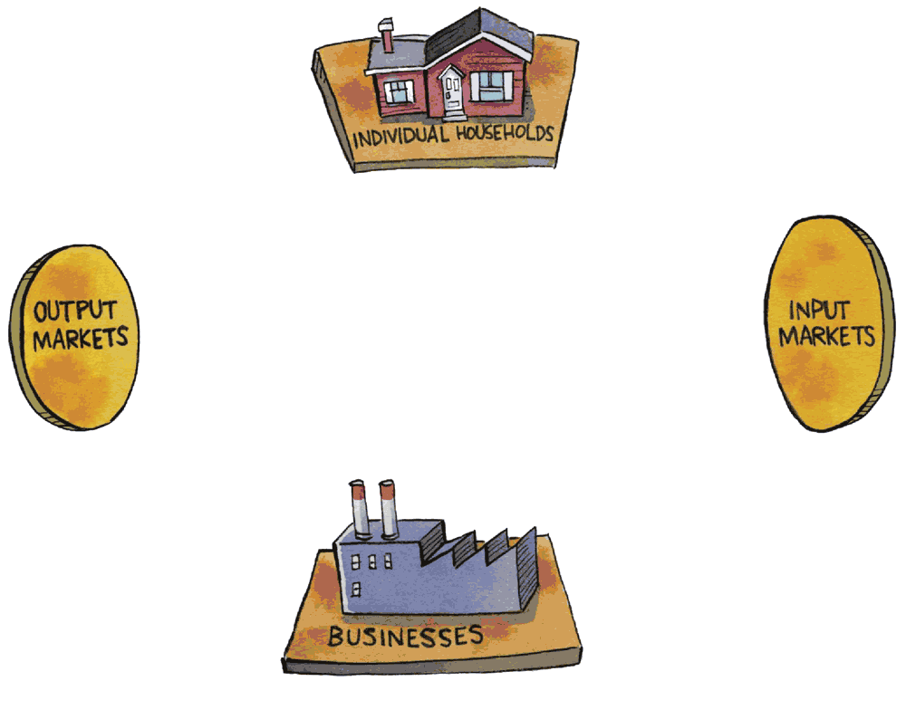
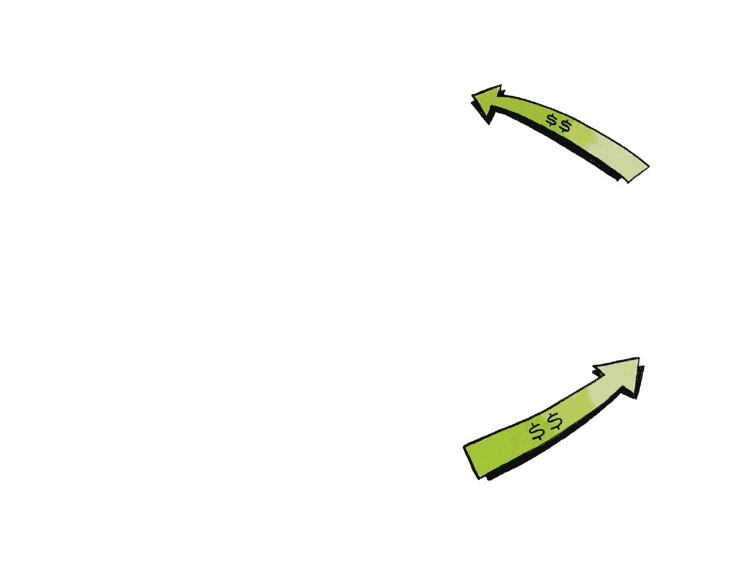
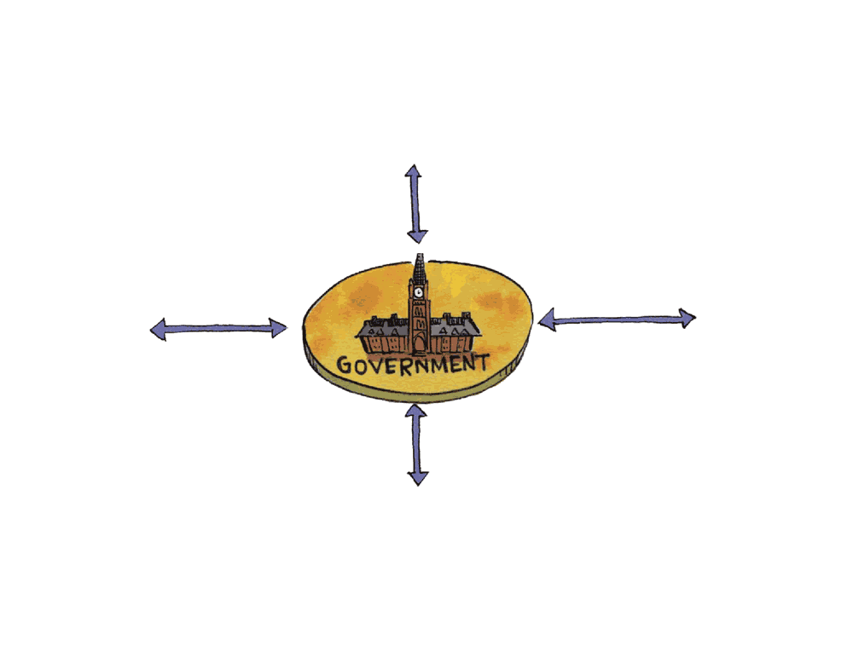
Circular Flow of Economic Life

Slide 12

Input markets determine incomes
Output markets determine the value of all products and services sold
Microeconomics focuses on interaction of demand and supply in input markets alone or output markets alone
Macroeconomics focuses on connections between input and output markets
Money, Banks, and Expectations are part of macro focus on whole economy

Slide 13
Governments set rules of the game and can choose to interact in any aspect of the economy, including policy
Economic models assume all other things not in the model do not change
The mental equivalent of controlled experiments in a laboratory
Say’s Law — supply creates its own demand

Slide 14
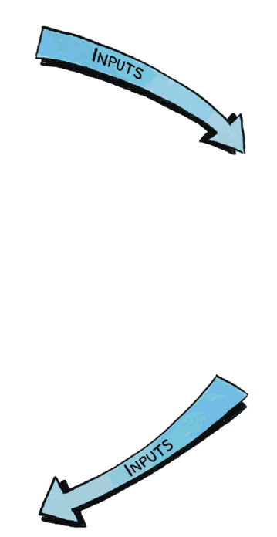
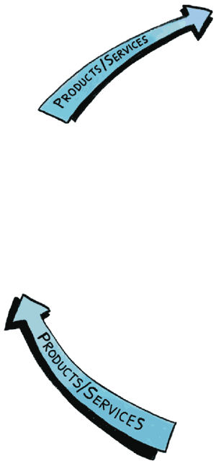
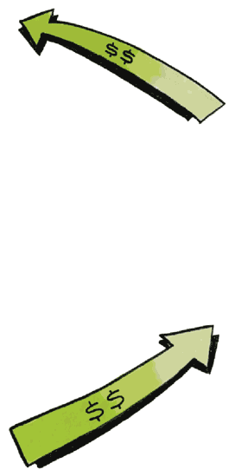
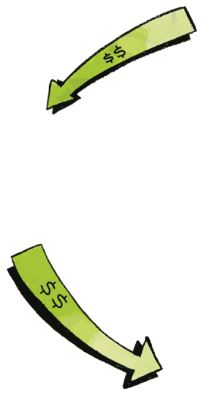
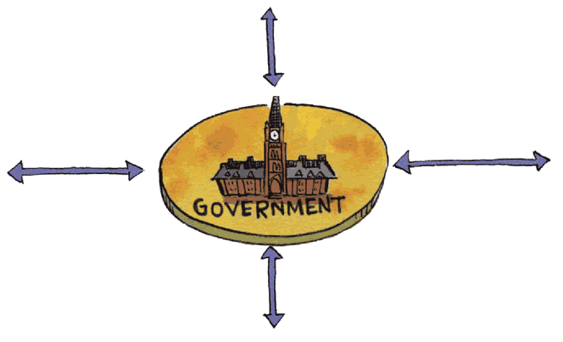
Circular Flow Model and Say’s Law

Slide 15
Circular Flow or Break?
?

Slide 16
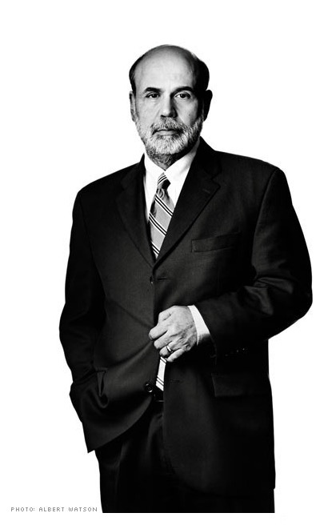
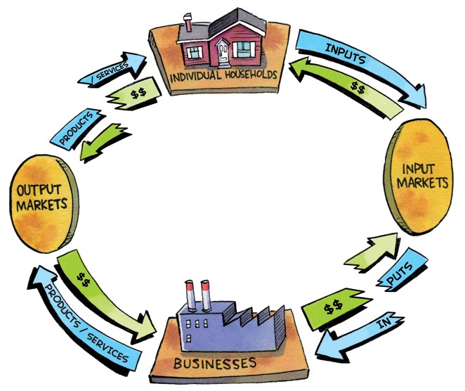
Why Ben Bernanke Chose Economics

Slide 17
The Fundamental Macroeconomic Question
“If left alone by government, do the price mechanisms of market economies adjust quickly to maintain steady growth in living standards, full employment, and stable prices?”
“Yes — Markets Self-Adjust” answer is based on Say’s Law — supply creates its own demand (F. Hayek)
“No — Markets Fail Often” answer is from J. M. Keynes, founder of macroeconomics in1930s

Slide 18
Notes:
https://www.youtube.com/watch?v=LCRNI04tnN8

Slide 19

ECONOMICS AND POLITICS
The “Yes” and “No” answers to the question “If left alone, do markets quickly self-adjust?” differ on the fallacy of composition, causes of business cycles, risk of government failure versus market failure, role for government, and political positions.

Slide 20
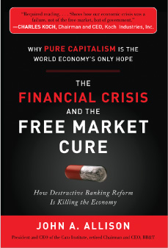
Like Say (and Hayek) and Keynes, economists and politicians today disagree about the fundamental macroeconomic question
Market failure market outcomes are inefficient or inequitable and fail to serve the public interest
Government failure government policy fails to serve the public interest
The “economic crisis was a failure, not of the free market, but of government”
-- Charles Koch

Slide 21

Yes — Left Alone, Markets Self-Adjust — Hands Off camp believes
Macroeconomic and microeconomic outcomes are the same
External events or government policy cause business cycles
Government failure is more likely than market failure
Government should be hands-off

Slide 22

No — Left Alone, Markets Fail Often — Hands On camp believes
Fallacy of composition — macroeconomic and microeconomic outcomes are different
Markets cause business cycles through connection failures between input and output markets, roles of money, banking, and expectations
Market failure is more likely than government failure
Government should be hands-on

Slide 23
Politicians on the political right tend to be in Yes — Markets Self-Adjust camp, so government hands-off
Politicians on the political left tend to be in No — Markets Fail Often camp, so government hands-on
There are also agreements between camps
Some role for government
Markets eventually adjust, but how long do they take?

Slide 24
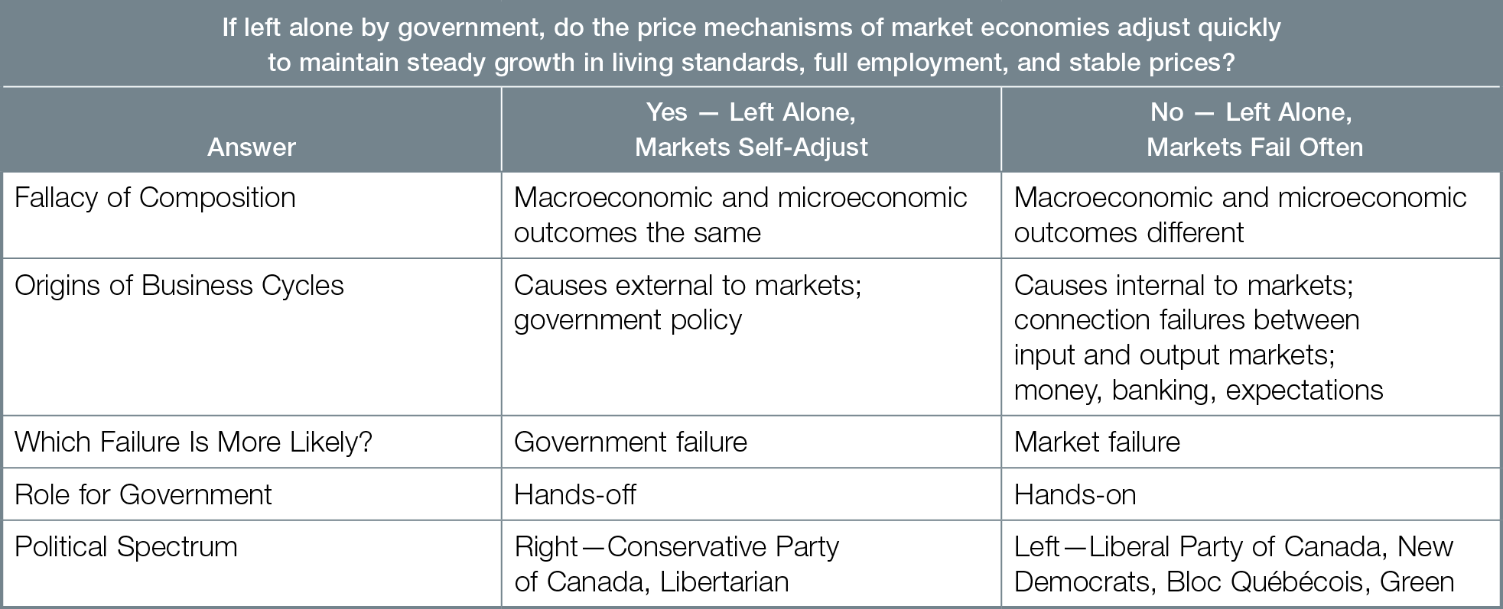
The Fundamental Macroeconomic Question

Slide 25
The Fundamental Macroeconomic Question
If left alone by government, do the price mechanisms of market economies adjust quickly to maintain steady growth in living standards, full employment, and stable prices ?”

Slide 26
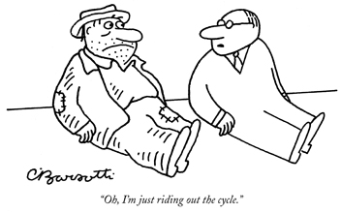
MACROECONOMIC OUTCOMES AND PLAYERS
Three key performance outcomes of the Canadian economy are GDP, unemployment, and inflation; produced by the choices of five macroeconomic players — consumers, businesses, government, Bank of Canada and the banking system, and the rest of the world.

Slide 27

OUTCOMES
Good outcomes are
higher gross domestic product (GDP)
lower unemployment
low and predictable inflation

Slide 28
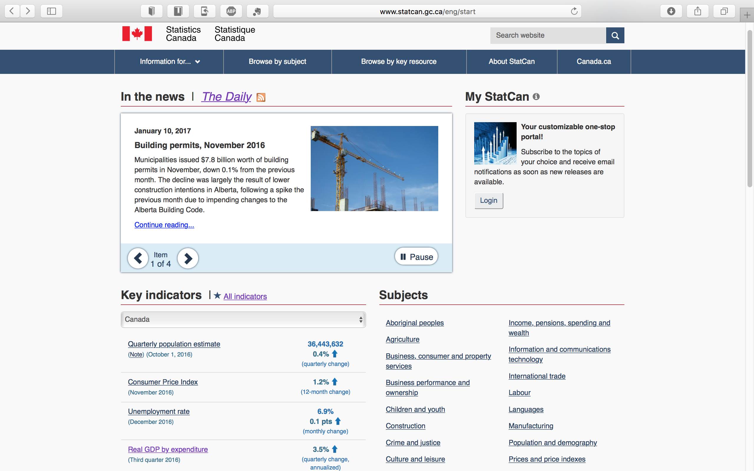
Notes:
http://www.statcan.gc.ca/eng/start

Slide 29


PLAYERS
Consumer choices
Spend income or save
Buy Canadian products and services, or imports
Business choices
Investment spending business purchases of new factories and equipment
Hiring workers or not
Buying inputs domestically or importing
Selling outputs domestically or exporting

Slide 30


Government choices
Buying products and services
Fiscal policy government purchases, taxes / transfers to achieve the macroeconomic outcomes
Bank of Canada and banking system choices
Monetary policy Bank of Canada changes interest rates and supply of money to achieve the macroeconomic outcomes
Making loans or not

Slide 31

Rest of World (R.O.W.) choices
Buying Canadian exports or not, selling imports to Canada or not
Investing money in Canada or not, accepting Canadian investments or not

Slide 32
WHY YOU SHOULD THINK LIKE A MACROECONOMIST
Macroeconomics affects your future — GDP affects living standards, unemployment affects the odds of your finding a job, and inflation can reduce your living standards. Macroeconomics also informs your vote for politicians and policies influencing economic performance, and illuminates the important parts of complex economies.

Slide 33
Your personal economic success is affected by
GDP higher GDP per person allows higher living standards
Unemployment affects odds of finding a job
Inflation reduces living standards if income does not rise as fast as the prices of what you buy
Interest rates, exchange rates, and government taxes and transfer payments

Slide 34


Understanding macroeconomics helps you make smart choices and informs your vote for politicians whose economic policies influence economic performance and your economic success
Thinking like a macroeconomist means using the circular flow model to focus on connections inside the economy and out to the rest of the world

Slide 35
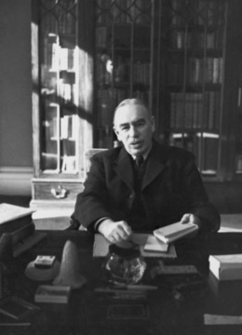
THINKING LIKE AN ECONOMIST
“Economics does not furnish a body of settled conclusions immediately applicable to policy. It is a method rather than a doctrine, an apparatus of the mind, a technique of thinking which helps its possessor to draw correct conclusions.” − John Maynard Keynes

Slide 36
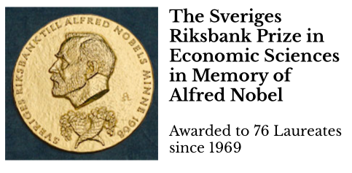
IS ECONOMICS A SCIENCE ?
Science is a systematic enterprise that builds and organizes knowledge in the form of testable explanations and predictions about the universe
Economics uses quantitative expression in mathematics and concise statement of its models in axioms and derived “theorems,” so it looks a lot like the models of science from physics
“Nobel Prize” in Economics (but see Controversies- Criticisms in Wikipedia entry)

Slide 37
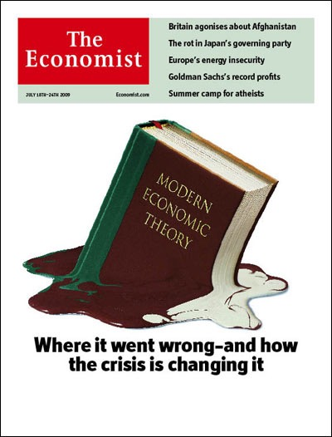
Economics lacks the most important aspect of science – “a record of improvement in predictive range and accuracy”
A. Rosenberg & T. Curtain, “What Is Economics Good For?” (New York Times 24 August 2013)
Paul Krugman, “How Did Economists Get It So Wrong?” (New York Times 6 Sept 2009)

Slide 38
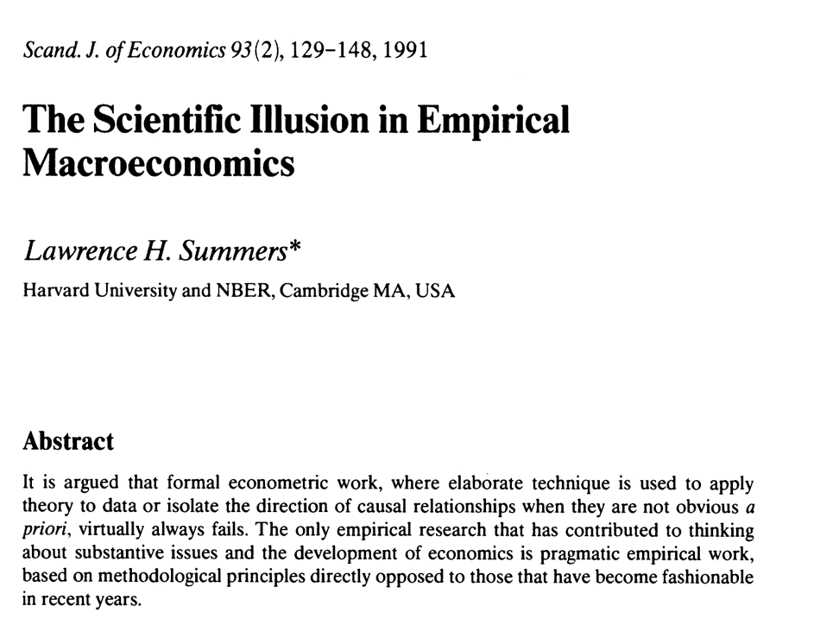
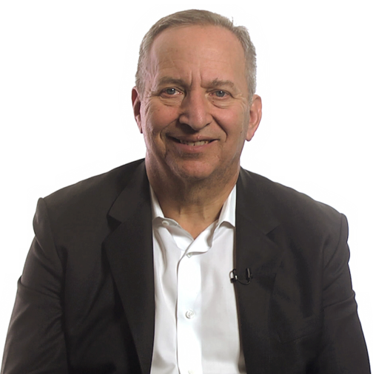
Notes:
range and accuracy”

Slide 39
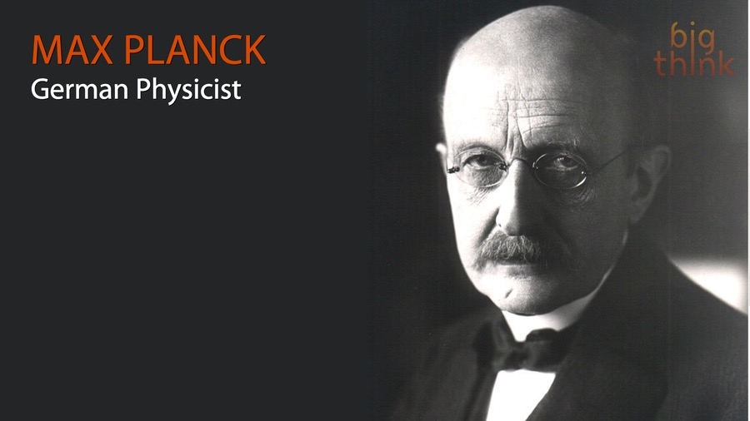
“Professor (Max) Planck, of Berlin, the famous originator of the Quantum Theory, once remarked to me that in early life he had thought of studying economics, but had found it too difficult! ”
– John Maynard Keynes
Notes:
“Professor Planck could easily master the whole corpus of mathematical economics in a few days. He did not mean that! But the amalgam of logic and intuition and the wide knowledge of facts, most of which are not precise, which is required for economic interpretation in its highest form is, quite truly, overwhelmingly difficult for those whose gift mainly consists in the power to imagine and pursue to their furthest points the implications and prior conditions of comparatively simple facts which are known with a high degree of precision.”

Slide 40
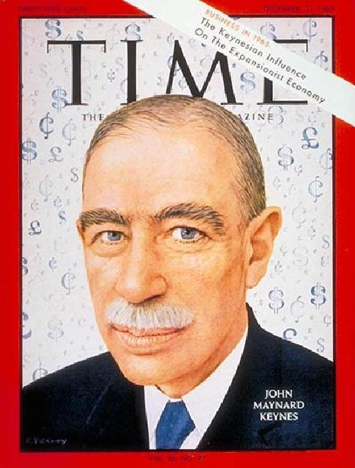
“Economics is a science of thinking in terms of models joined to the art of choosing models which are relevant to the contemporary world.
It is compelled to be this, because, unlike the typical natural science, the material to which it is applied is, in too many respects, not homogeneous through time. The object of a model is to segregate the semi-permanent or relatively constant factors from those which are transitory or fluctuating so as to develop a logical way of thinking about the latter …. ”
– John Maynard Keynes

Slide 41
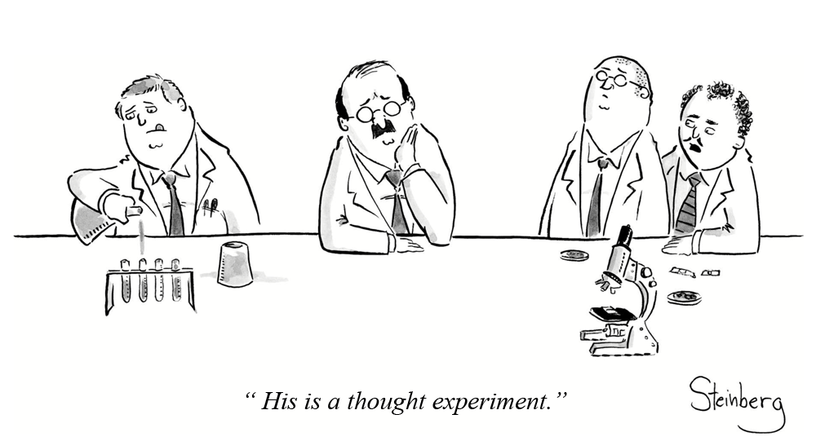
THINKING LIKE AN ECONOMIST

